Slide 1
P1 Drills
Nursery Drills
Drill 4
Drill 5
Drill 5
Drill 4
Drill 3
Extra Drill
Drill 3
Drill 2
Drill 1
Drill 2
Drill 1

Slide 2
Main areas for development
Locomotor skills
Body Management Skills
Object Control Skills
Team interaction Skills
Locomotor skills
Crawling
Running
Hopping
Skipping
Jumping
Dodging
Body Management Skills
Rolling
Stopping
Balancing
Climbing
Landing
Twisting
Object Control Skills
Throwing
Catching
Kicking
Striking
Dribbling
Bouncing
Roll / Jab lifting
Team interaction Skills
Passing
Team races

Slide 3
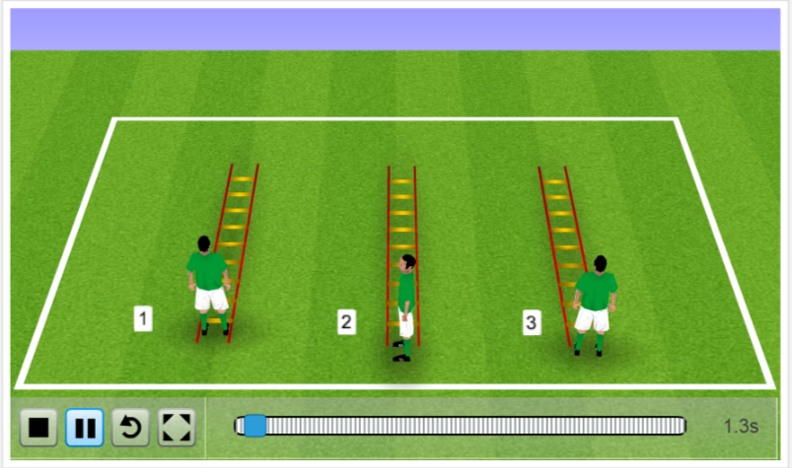
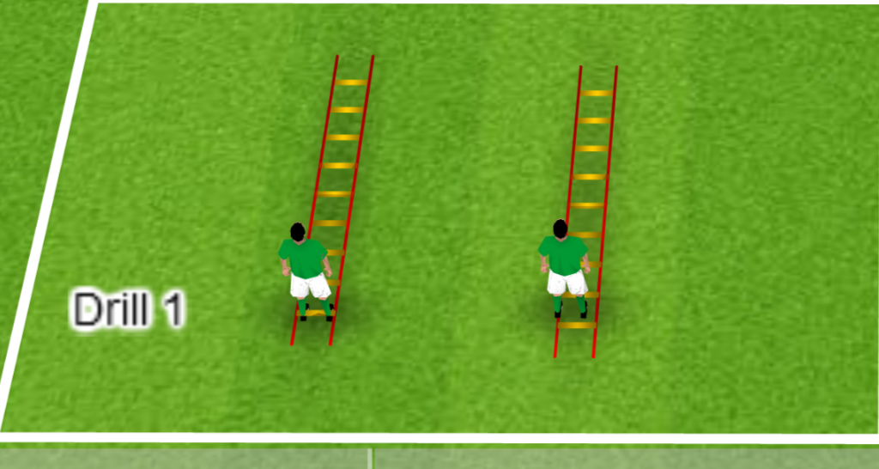
Drill Area 1
Ladder and jumping drills – Locomotor Skills
Progressions
Do drills on 1 foot
Do drills with hands on head
Do drills as a race
Replace ladders with hurdles
With hurdle try to encourage touching toes for each jump
2 Feet together and jump forward through ladder
2 Feet together and jump Sideways through ladder
2 Feet together and jump forward 2 back 1
Click here to see drill animation

Slide 4
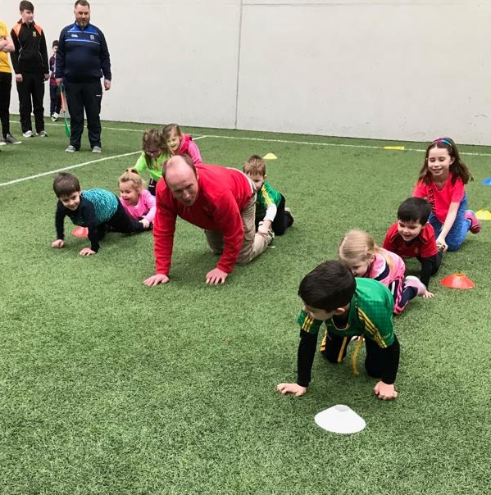
Drill Area 2
Ladder and jumping drills –
Locomotor and body management Skills
Progressions
Bounce ball at each cone
Pass ball back at last cone
Make player circle each cone
Move cones closer together
Run / Hop / Crawl
In and out through cones
Caterpillar Race
Hold ankles of player in front of you
Dribble ball through cones

Slide 5
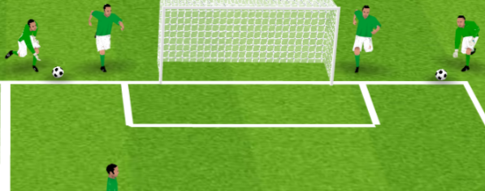
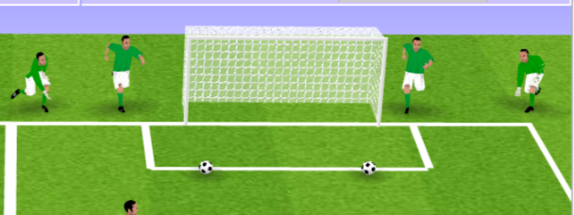
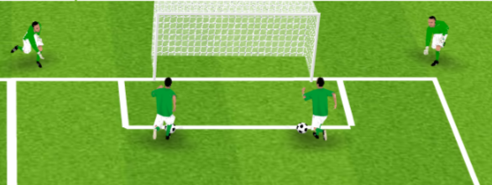
Drill Area 3
Stopping and Striking –
Object control and locomotor Skills
Coach and player start on end line
Coach rolls the ball to the edge of the small square and player chase's it – stops it and shoots into goal
Click here to See drill animation
Progressions
Race against other team 1 ball per player
Make goals smaller
Add cones player has to avoid when chasing the ball

Slide 6
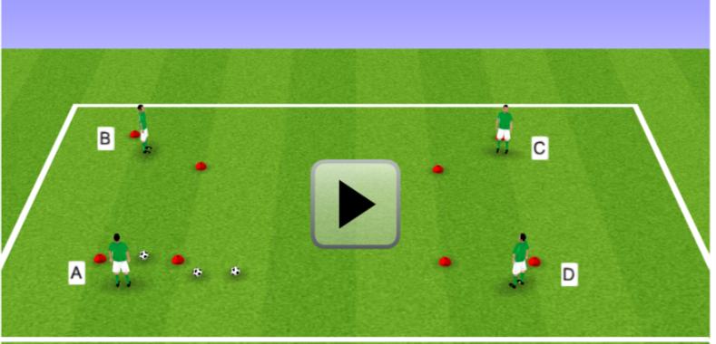
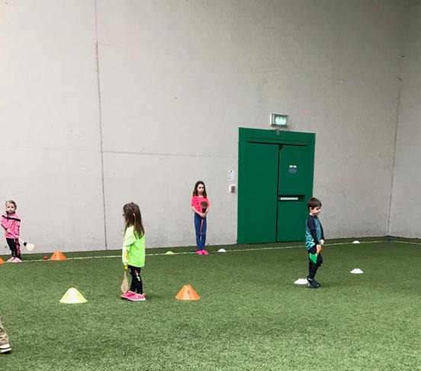
Drill Area 4
Striking and Passing Square –
Object control and interactive Skills
Progressions
Race against other team
Make cone goals smaller
Player a has 3 balls and the object of the game is to pass (kick or strike) the 3 balls around the square one by one as fast as they can.
Click here to see drill animation

Slide 7
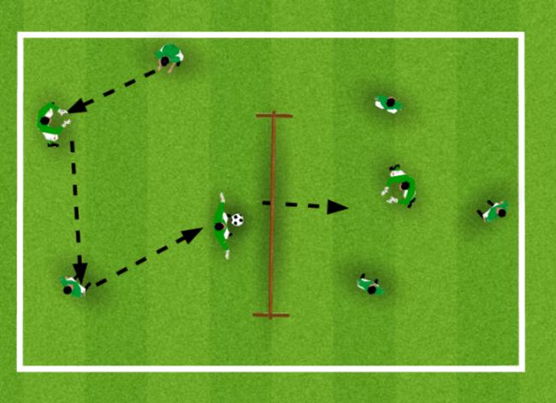
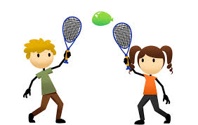
Drill Area 5
Balloon tennis / Gaelic Hand-pass Tennis –
Object control and interactive Skills
All Players on each team touch the ball / balloon and then get it over the net
Other team try to catch the ball pass it around and hit back over the ‘net’
Click here to see drill animation
Progressions
Use hurleys with balloon
Make net higher

Slide 8
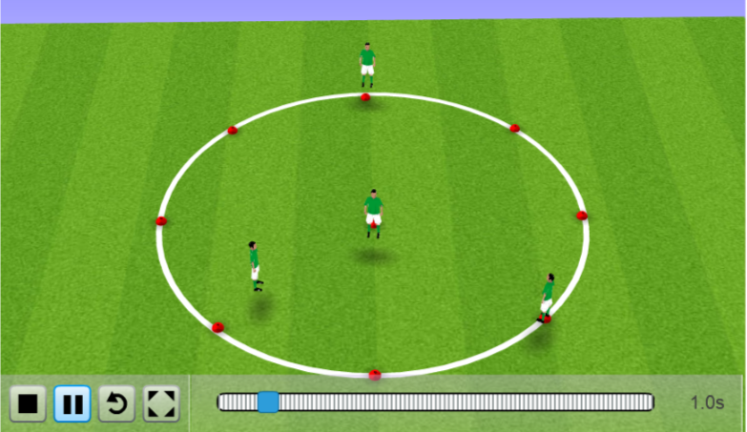
Extra Drill Area
Free Cone drills –
Locomotor and body management Skills
Progressions
Add more players and cones
2 players have to swap positions without letting middle player know they are going to run
1 player stands at centre cone with 3 or 4 players spread out at the outer cones.
Players at outer cone have to run to a free cone
Cannot run to the cone next to them
Click here to see drill animation

